Slide 1
Stormwater Utility Fee
Draft Phase 2
Credit Policy
June 21, 2018

Slide 2
Why Adopt SWU?
July 2013 – New state/federal mandates requiring infrastructure investments
  Chesapeake Bay ‘Pollution Budget’
February 2016 - Council direction
  Creating framework; conduct outreach
May 4, 2017 – Council adopted SWU framework and ordinance
May 15, 2018 – 1st half on RE bill
June 15, 2018 – 1st half due
Notes:
Capture program costs
Maximize equity
Minimize administrative cost
Maximize understandability

Slide 3
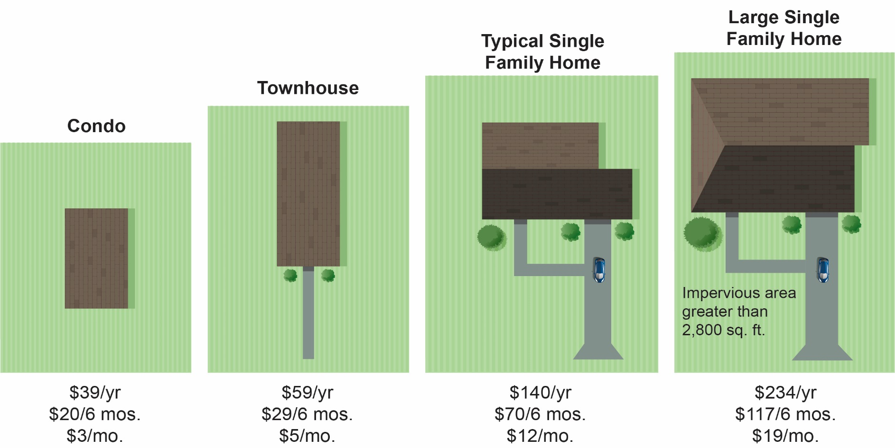
Single Family Residential Fees
  Fixed-Fee, Tiered approach, based on Property Type
$39.20/yr
$19.60/6 mos.
$58.80/yr
$29.40/6 mos.
$140.00/yr
$70.00/6 mos.
$233.80/yr
$116.90/6 mos.
  1 ERU = 2,062 sq. ft.

Slide 4
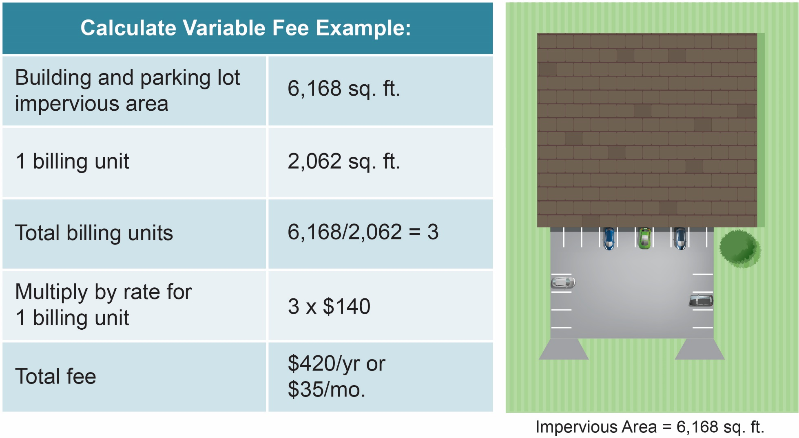
Calculated
Non-Residential Fee

Slide 5
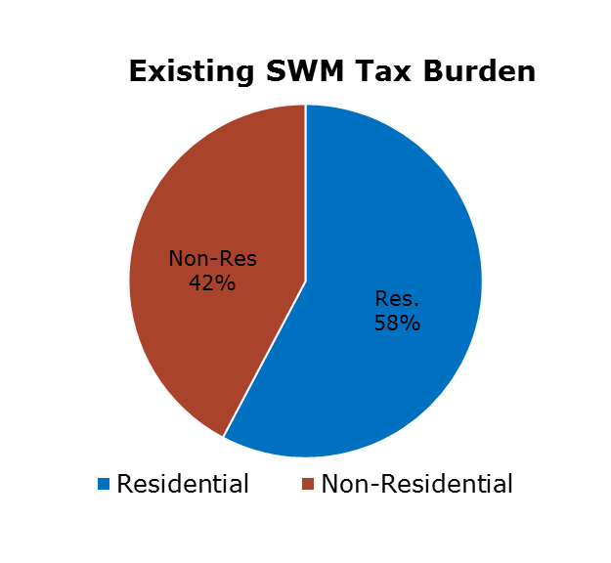
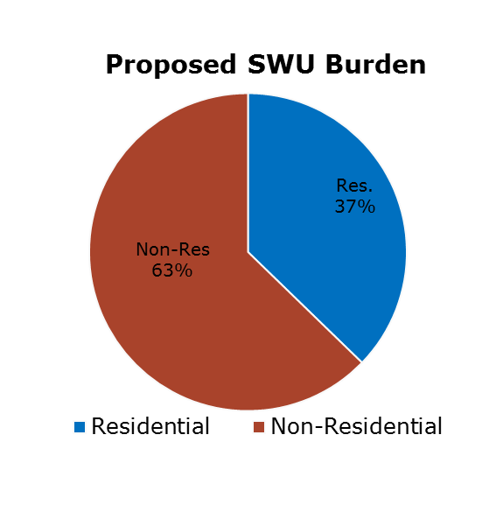
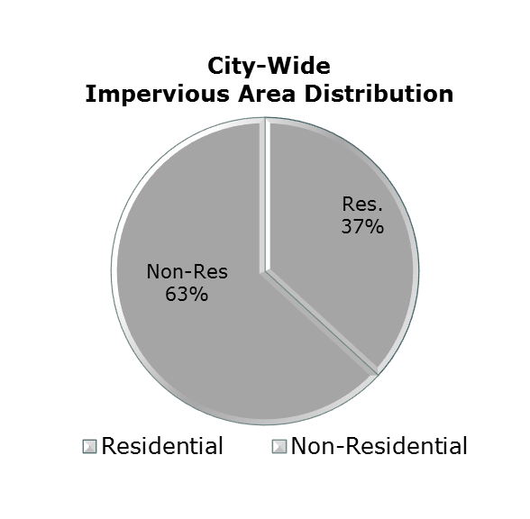
Tax Rate vs. Fee Funding: Creating Equity
Tax Rate
SWU Fee
NOTE: Fee applies to non-profits and faith-based properties that currently do not pay real estate taxes.

Slide 6
Credit Policy Schedule
November
2018
2nd half Stormwater Fee due November 15
City develops phase 2 application process
September – October 2018
Public meeting or open house on draft recommended credit policy
Phase 2 Credit Policy considered by City Council
July – August
2018
City drafts phase 2 credit manual
City drafts application forms
Ongoing presentations, as requested
April – June
2018
December – February ‘19
Credit Application Window opens December 1
Credit Applications due February 15
April feedback form on BMPs
Presentations to civic and business associations
1st half Stormwater Fee due June 15
Outreach at Farmers Market, Earth Day
October ‘17- March
City Council adopts Phase 1 credit policy
City develops online application tool
1st annual credit application window opens
December 1
Application window closed February 15

Slide 7
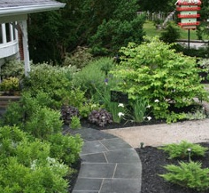
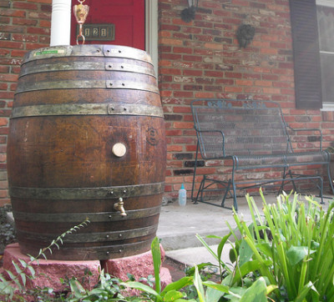
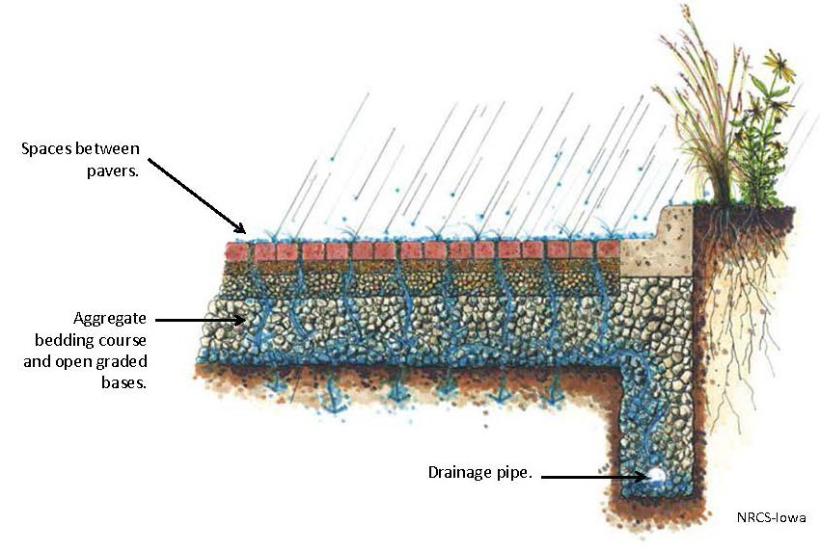
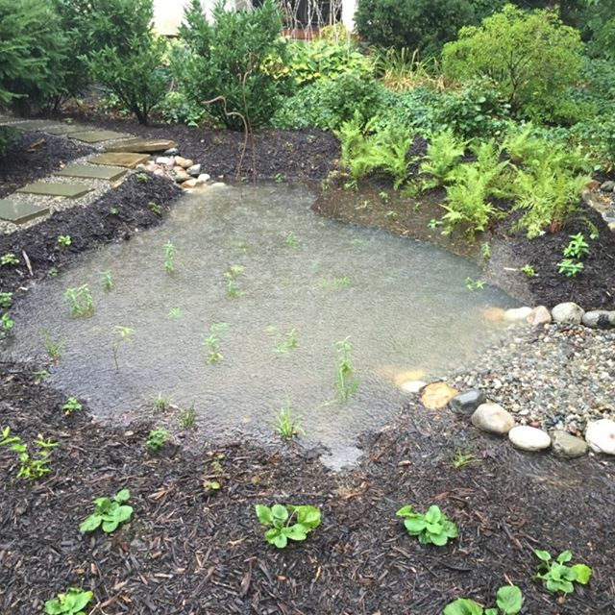
Draft Menu of Options
Townhomes and Detached
  Practices on Menu:
  Annual practices
  Green infrastructure practices requiring annual maintenance
Conservation Landscaping
Rain Barrel
  Credit Amount:
  Flat credit for each
  Max 30% combined
  Documentation:
  Annual requirements
  Self-certification of proper functioning
Rain Garden
Permeable Pavement

Slide 8
Draft Menu of Options
Townhomes and Detached
Practice |  | Credit
No Fertilizer Pledge |  | 3%
Rain Barrel |  | 3% each, up to 4
New Tree Planting | Townhouse | 5% for 1 tree, Max 10%
 | Typical SFH | 5% for 2 trees, Max 10%
 | Large SFH | 5% for 3 trees, Max 10%
Flow Thru Planter Box |  | 10%
Cistern |  | 10%
Conservation Landscaping |  | 10%
Rain Garden |  | 15%
Dry Well/Infiltration Practice |  | 15%
Permeable Pavement |  | 20%
Vegetated Green Roof |  | 20%

Slide 9
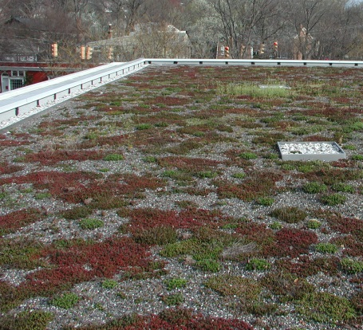
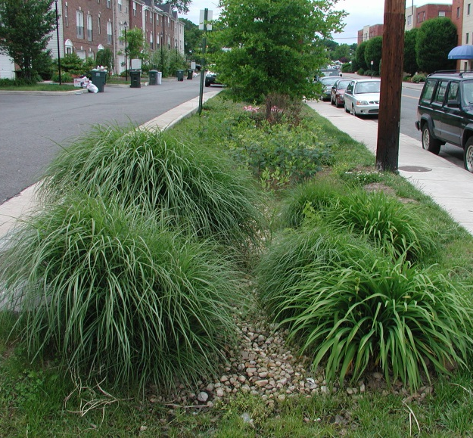
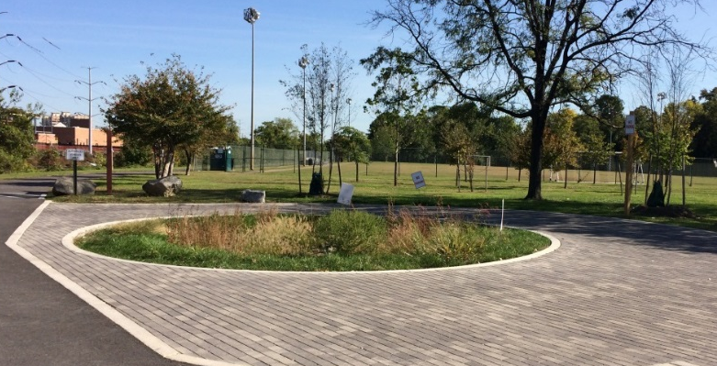
Draft Phase 2
Structural Credits
  Eligible Structures:
  Mandatory BMPs and Detention Facilities
    All properties
  Voluntarily installed Green Infrastructure BMPs
    Condominiums
    Non-Residential
Green Roof
Bioswale
  Credit Amount:
  City Calculates based on % of Impervious Area Treated
  Max 20% BMP
  Max 10% Detention
Permeable Pavement and Bioretention Cell

Slide 10
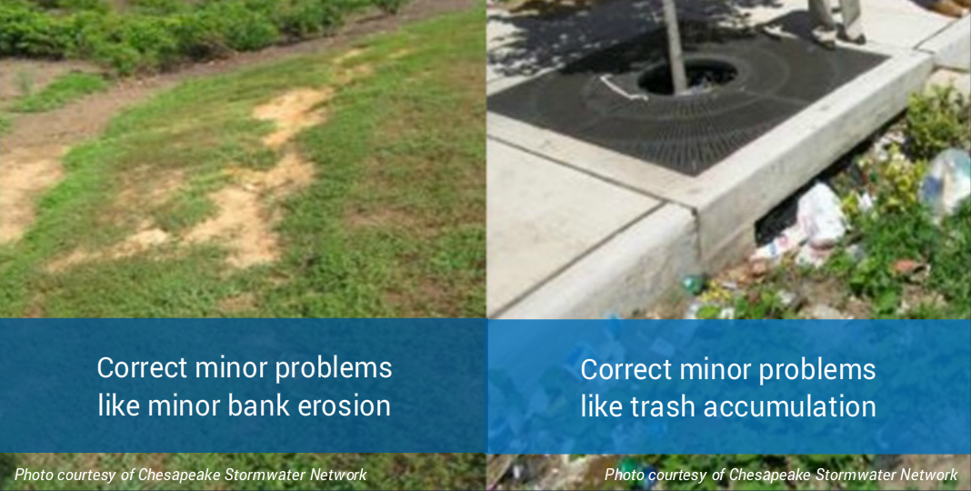
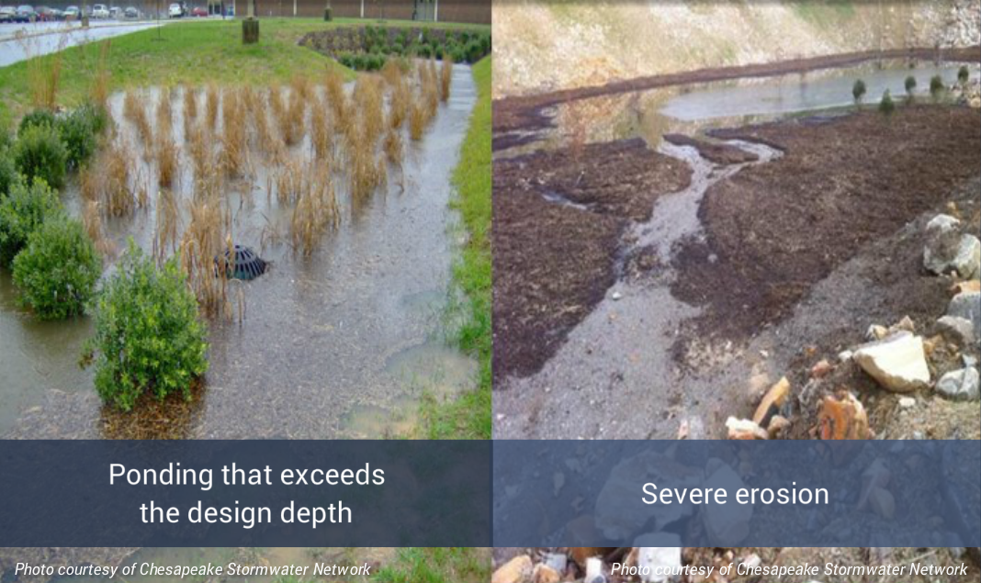
Draft Phase 2
Structural Credits
  During the year:
  Inspect annually per recorded maintenance agreement
  Perform needed maintenance
  Qualified professional certifies that the structure is properly functioning
  By February 15:
  Apply online
  Window opens December 1
  Credits are split May and October bills

Slide 11
Overall Credit Policy
Who? | What? | How Much?
Townhomes and Detached Single Family Homes | Flat Credit Menu | 30% Max
All properties | Mandatory Structural Stormwater Facilities* | 20% Max for BMP 10% Max for Detention
Residential Condos and Non-residential | Green Infrastructure BMP | 20% Max
Residential Condos | Nutrient Management Plan | 10% Max
Residential Condos | Tree Planting Projects | 10% Max
Non-residential | Adopt-A-Waterway* Adopt-A-Block* Adopt-A-Storm Drain* | 10% Max for each, 30% Max total
Max combined 50% credit for any property.

Slide 12
Contacts
Jesse Maines, Division Chief
Rachael Moxley, P.E., SWU Manager
Danilo Nunez, P.E., SWU Engineer
Phone: 703-746-6499
Email: stormwater@alexandriava.gov
Web: www.alexandriava.gov/stormwater

