Slide 1
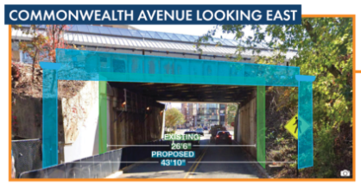
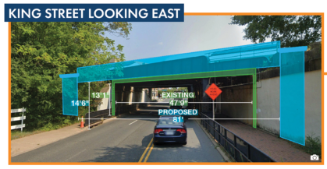
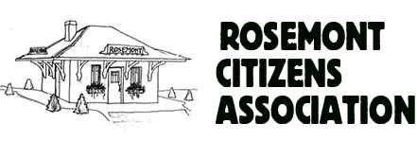
1. Rail Bridges
Status:
“60% Design” complete
City staff meeting with PELT regarding traffic impacts
Construction planned to start in 2024
To stay informed:
At RosemontPELT Website, click on
- King & Commonwealth Infrastructure Improvements
- Alexandria Fourth Track Project
PELT Update – March 2024

Slide 2
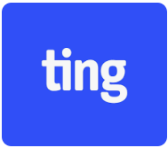
2. TING Installation
Status of Micro-trenching
Process Improvements
PELT Update – March 2024

Slide 3
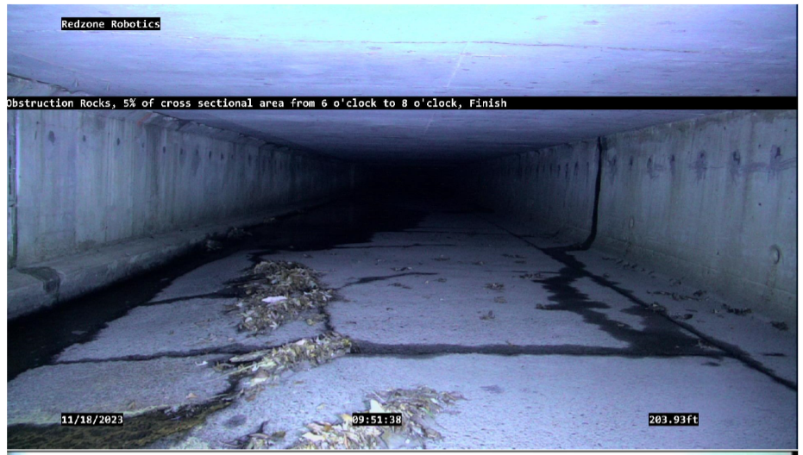
3. Flood Mitigation
Happening Now:
Culvert upgrade complete this month
Annual video inspection & cleaning
Sanitary sewer manholes & connector pipes
being renovated in East Rosemont
Future Plans:
May: PELT meeting with AlexRenew and T&ES on Commonwealth Interceptor Upgrade
Late summer: Public meeting on preliminary design of Hooff’s Run Culvert Bypass
Inside the Hooff’s Run Culvert – November 2023
PELT Update – March 2024

Slide 4
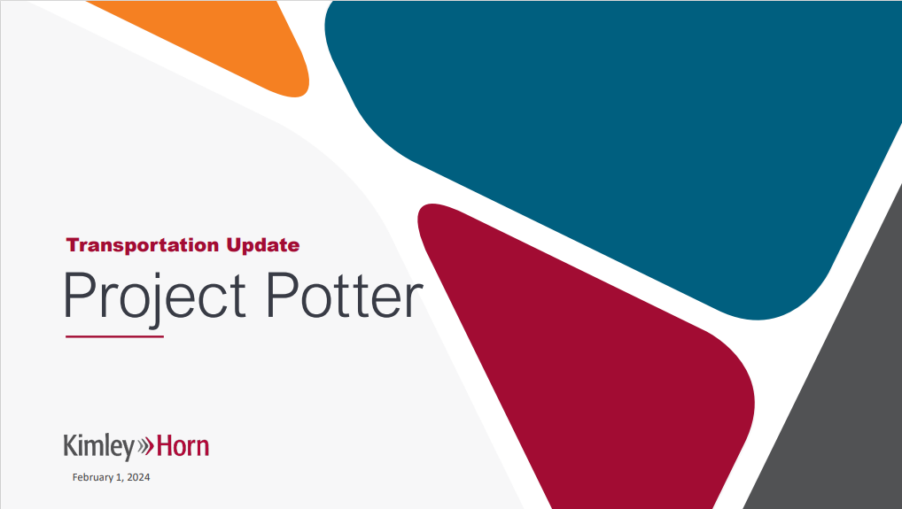
4. Potomac Yard Entertainment District – Traffic Study
Worst Case Scenario Modelled
7.5 million sq ft of Phase 1 fully built out
20,000 seat arena 100% filled
Rush Hour event
Modelling Assumptions
50% travel by Metro
2,500 on-site parking spaces, 3,600 in Crystal City, 5,000 within a few Metro stops
Same DC/Md/Va distribution as today
Traffic Study on RosemontPELT.com
Necessary Additional Metro/Road Investments
$35-70 million for Metro (plus $3-7 million/year)
$65 -100 million involving Route 1
$35-45 million involving Glebe Rd
Impact of Arena according to Model & Assumptions
(relative to 7.5M sq ft of Phase 1 fully built out but without arena)
1,700 additional cars/hour inbound
4,300 additional passengers/hour inbound on Metro
Travel time by car roughly the same with or without arena
PELT Update – March 2024

Slide 5

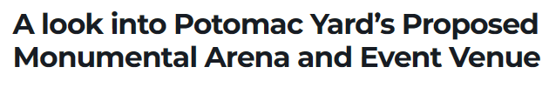
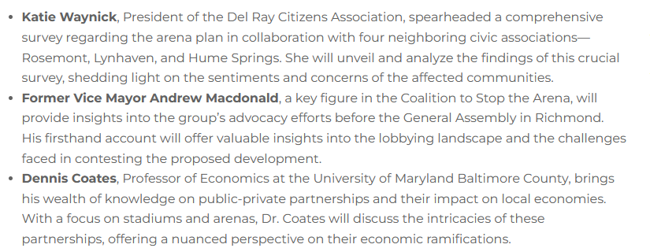
4. Potomac Yard Entertainment District - Upcoming Event
Monday, March 25 at 7pm
Alexandria Lyceum
PELT Update – March 2024

